Slide 1
OpenFlow Based Load Balancing for Fat-Tree Networks
Şehriban ALPAYDIN 504151346 | Büşra TEMEL 504141337 | Emre YALÇIN 504121341
May 3, 2016

Slide 2
OUTLINE
Brief Information About Load Balancing by Using SDN (Software Defined Network)
Tools and Installations (Floodlight, Mininet etc.)
Basic Consept
Proposed Load Balancing System

Slide 3
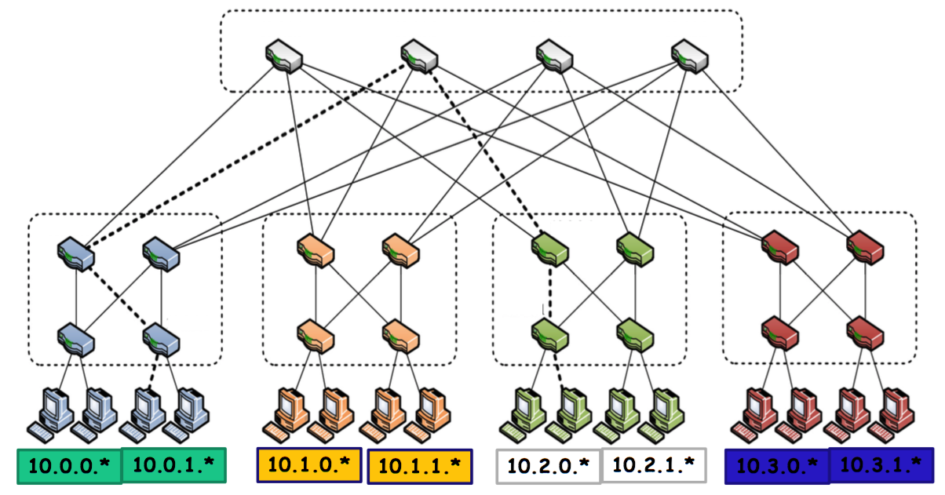
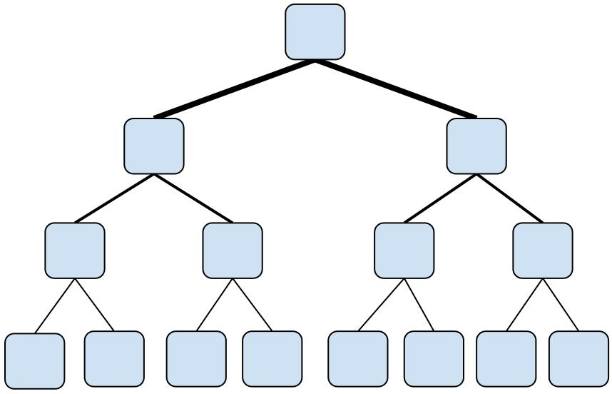
LOAD BALANCING IN FAT- TREE TOPOLOGY
Netwok Target :
Maximising system throughput
Minimising network latency
Resolution :
< Load Balancing >

Slide 4
LOAD BALANCING BASED ON HASH
In traditional networks, load balancing process is based on hash calculations of packets
Each packet of a flow follows the single pre-defined path through the network
When something happen like a switch breakdown or physical layer damage, packets tend to drop or the other switches need to be manually configured for choosing a different path.
All links gets the same percentage of hash values, this means all paths have the same capacity

Slide 5
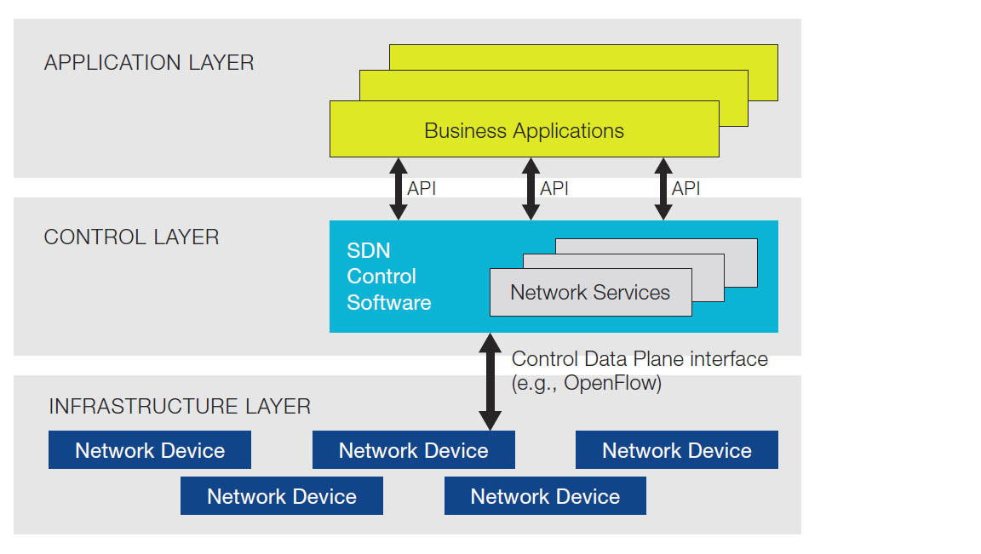
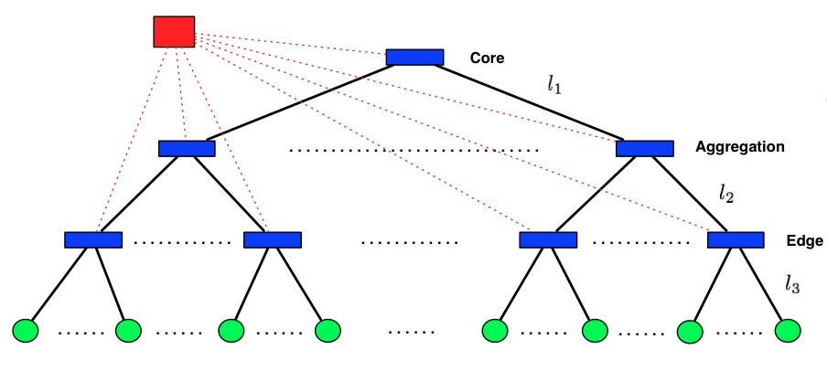
LOAD BALANCING BASED ON SDN
Central controller makes the decision where the packet will be send
Detects the topology by listening to the switches and calculates available path with less load
Directs the switches with forwarding entries needed for the paths
Floodlight

Slide 6
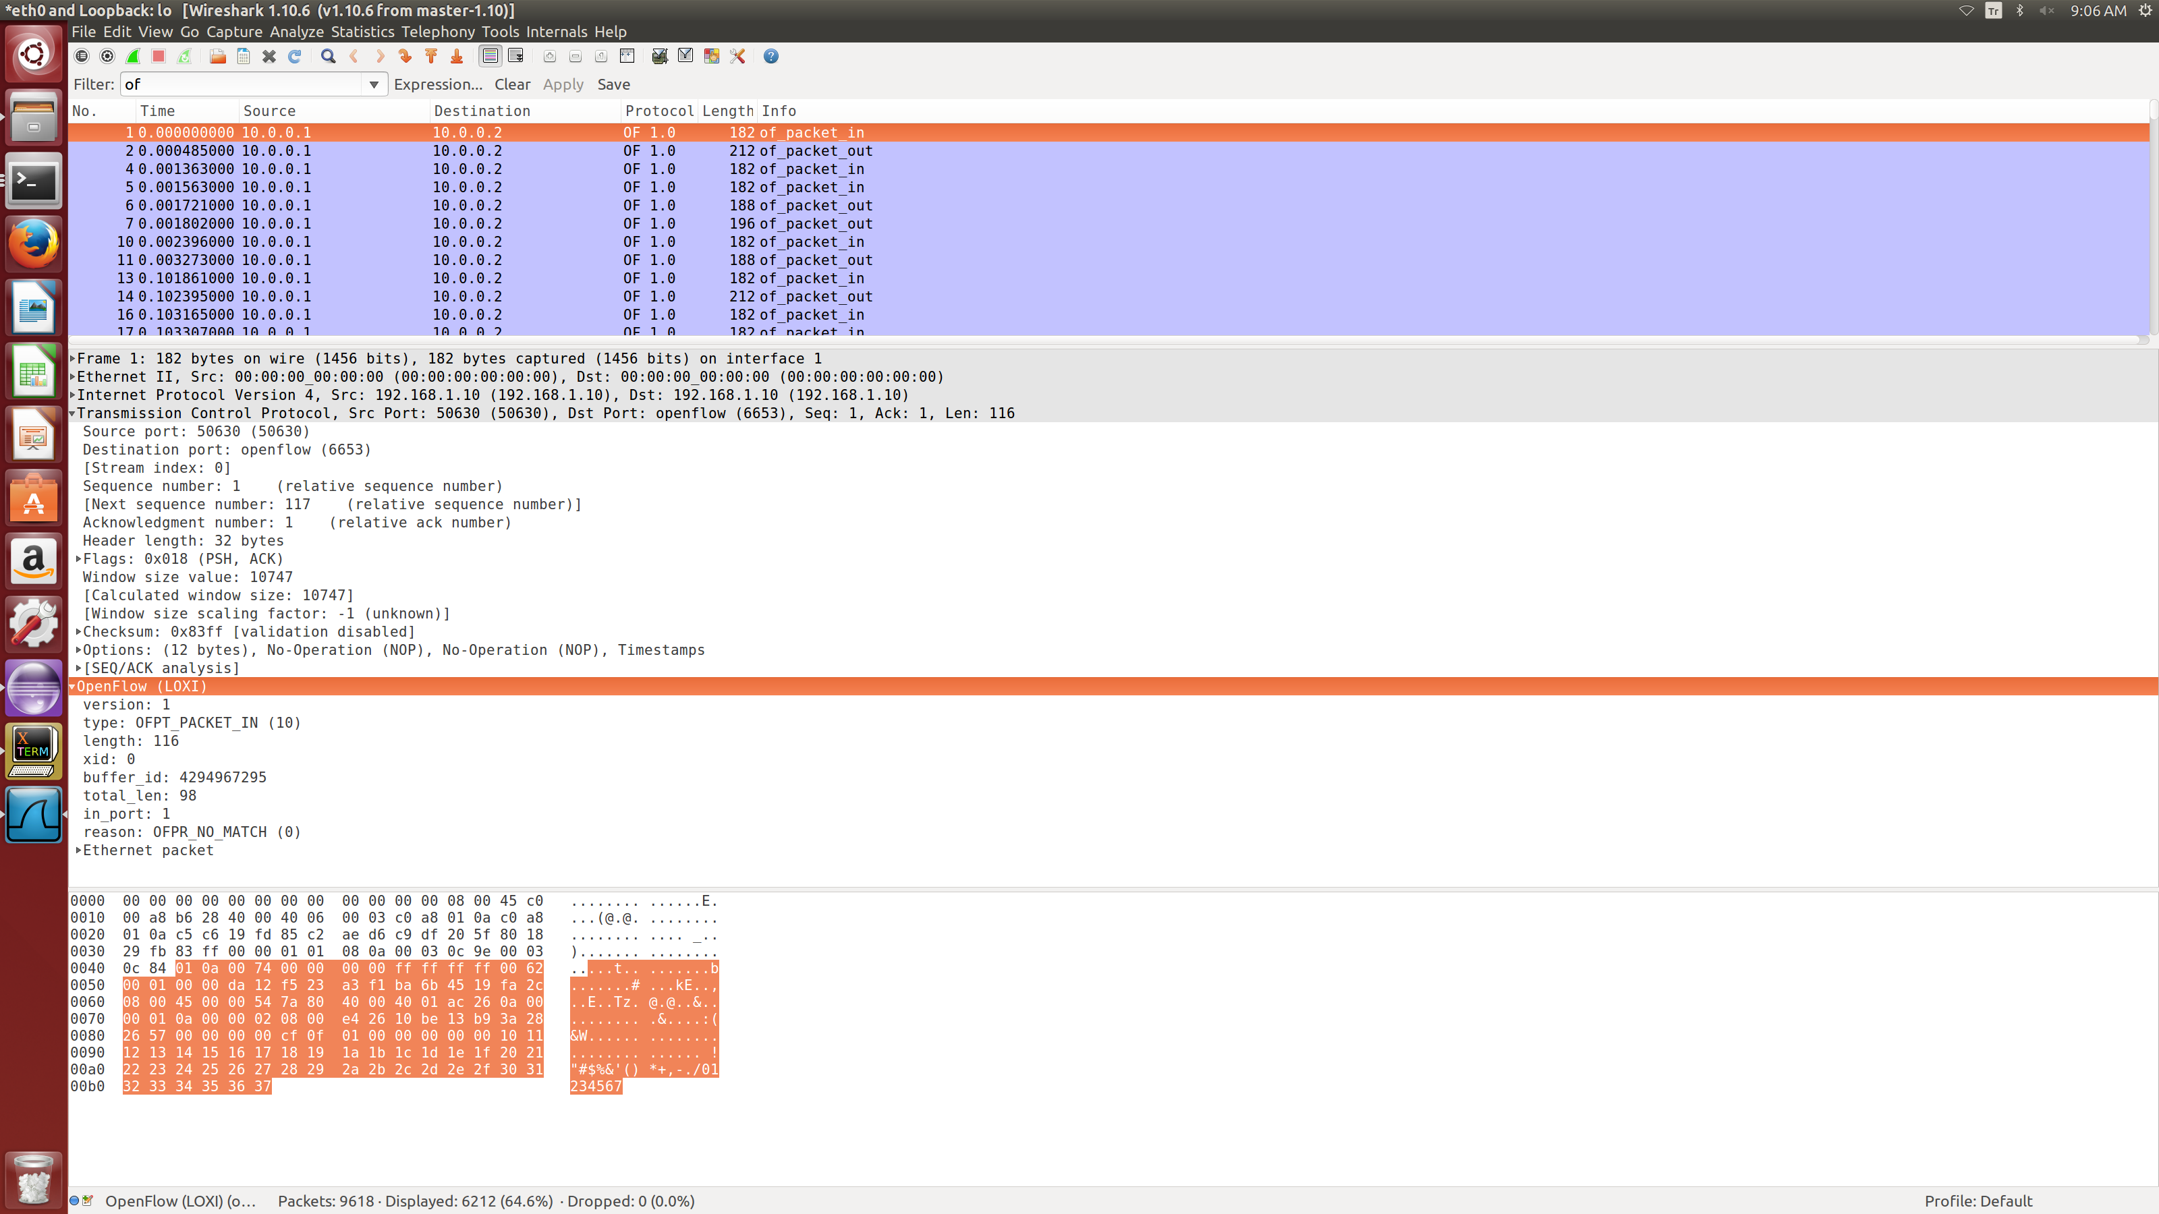
TOOLS
Mininet is used as a network emulator that creates a network of virtual hosts, switches, controllers, and links
Packets can be handled by the Mininet switches, with a given link speed and delay.
Mininet switches support OpenFlow as a communication protocol
Due to generate traffic, Iperf network testing tools will be used so that TCP or UDP data streams will be created accordingly. Bandwith, delay jitter and datagram loss can be monitored on Iperf.
Wireshark network packet analyzer let us to capture and interactively browse the traffic running on a network
WIRESHARK OUTPUT

Slide 7
TOOLS INSTALLATION
Install java components
Floodlight is written in java thus install jdk and ant by running;
$ sudo apt-get install build-essential default-jdk ant pythondev eclipse
Download and build the floodlight
$ git clone git://github.com/floodlight/floodlight.git
$ cd floodlight
$ git checkout stable
$ ant;
$ sudo mkdir /var/lib/floodlight
$ sudo chmod 777 /var/lib/floodlight
Run the floodlight
$ java -jar target/floodlight.jar
Simulate a network
It is possible to run Mininet against the locally running Floodlight (just type “sudo mn”)

Slide 8
BASIC CONSEPT
Activating the statistics module on floodlight
Running the controller
Creating the fat-tree topology on python for mininet
Creating traffic on the topology
Listening and rerouting the traffic by controller

Slide 9
Statistics Module on Floodlight
Determining the bandwidth used by switch ports
Configuring from startup using the floodlightdefault.properties file
Enable (TRUE) / Disable (FALSE) the statistics collection module
Set the interval at which request messages are sent and ports statistics are collected
Configuring at runtime using the Floodlight REST API
Plug in your own statistics types
e.g. Returning packets per second instead of bandwidth

Slide 10
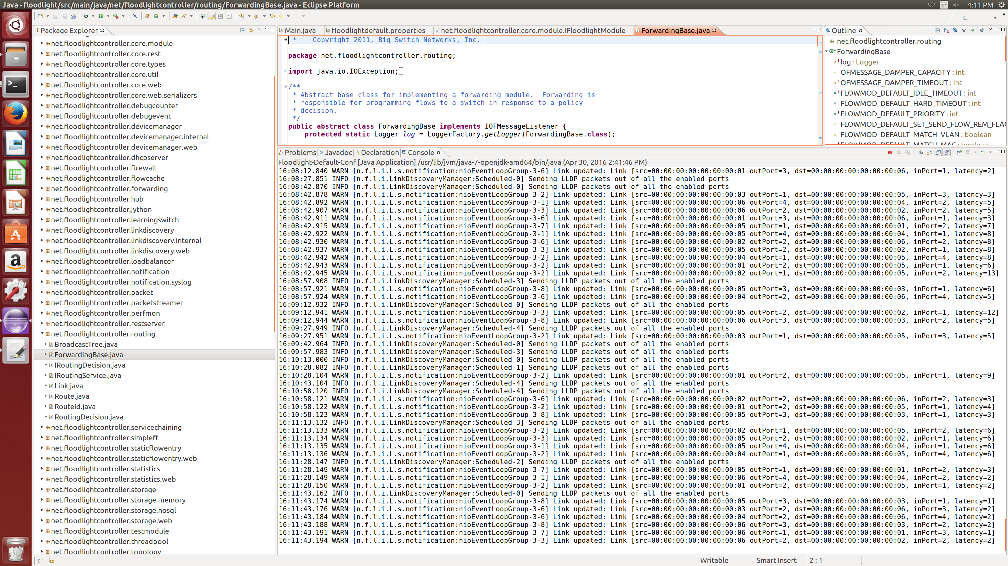
Running the Floodlight Controller

Slide 11
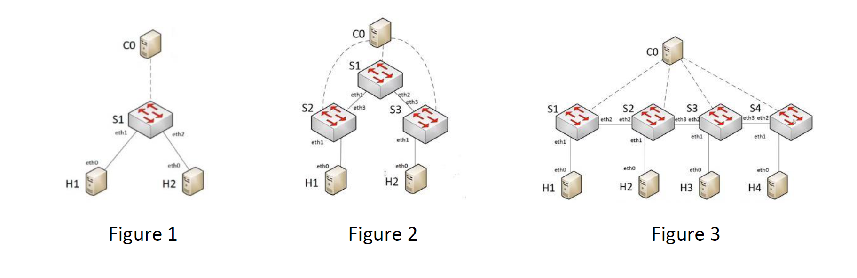
Fat-tree Topology on Python
Mininet default topologies
Command for Figure 1: $ sudo mn (default topology)
Command for Figure 2: $ sudo mn --topo=tree,2,2
Command for Figure 3: $ sudo mn --topo=linear,4

Slide 12
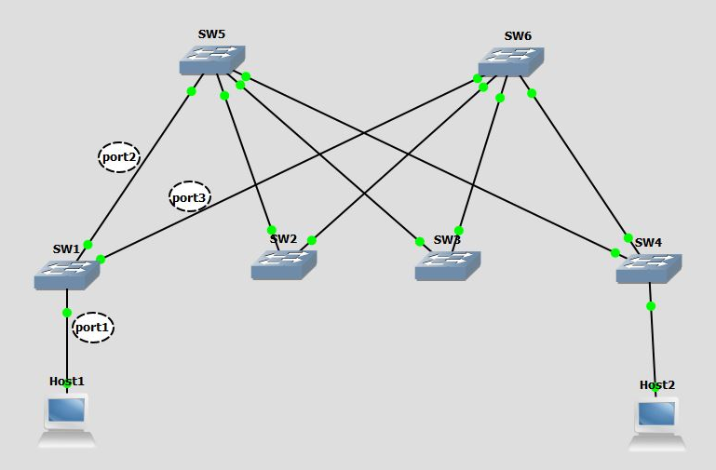
Mininet fat-tree topology
Data center environment requires high data traffic demand in each hosts.
Fat –tree network commonly used for this need.
In this network there are two important targets;
maximizing system throughput
minimizing network latency
Examples from python file:
host1 = self.addHost( 'h1' )
sw1 = self.addSwitch( 's1' )
self.addLink( host1, sw1 )

Slide 13
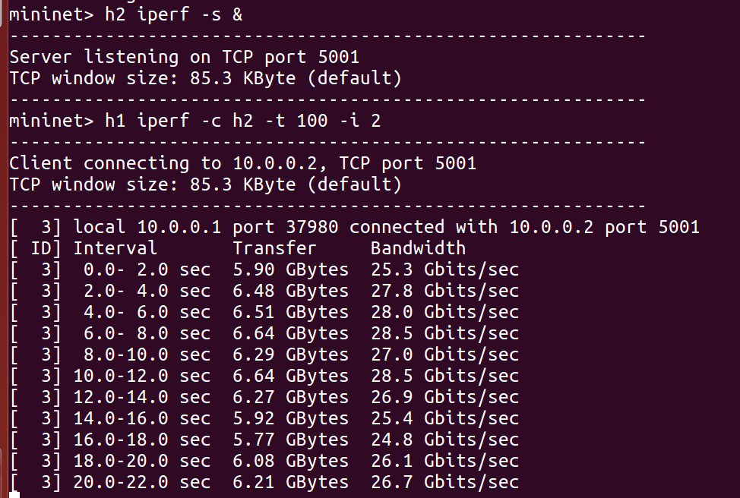
Creating Traffic on the Topology
TCP traffic is created from Host1 (10.0.0.1) to Host2 (10.0.0.2)
mininet> h2 iperf -s &
mininet> h1 iperf -c h2 -t 100 -i 2

Slide 14
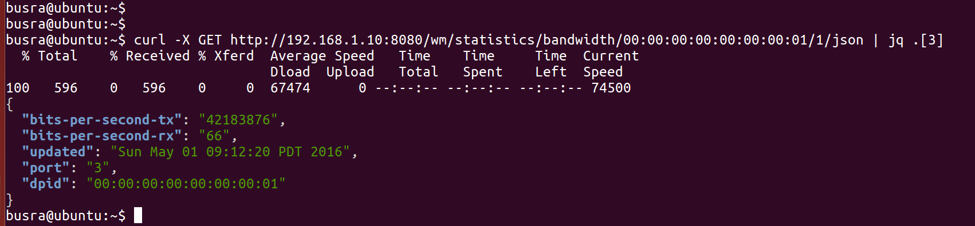
Listening and Rerouting the Traffic by Controller
Obtaining ports statistics
curl -X GET http://192.168.1.10:8080/wm/statistics/bandwidth/00:00:00:00:00:00:00:01/1/json
Rerouting the traffic
curl -X POST -d '{"switch": "00:00:00:00:00:00:00:01", "name":"flow-mod-1", "cookie":"0", "priority":"32768", "in_port":"1","active":"true", "actions":"output=2"}' http://192.168.1.10:8080/wm/staticflowpusher/json

Slide 15
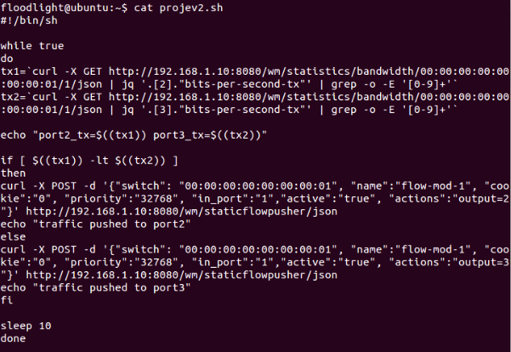
Evaluation
To achieve dynamic load balancing a bash script is used
Get statistical data from switch port
Compare ports tx rate
Decide more available port
Forward outgoing traffic from decided port
Repeat evey 10 seconds

Slide 16
TCP & UDP Tests
TCP traffic
mininet> h2 iperf -s &
mininet> h1 iperf -c h2 -t 100 -i 2
UDP traffic
mininet> h2 iperf -s &
mininet> h1 iperf -c h2 -t 100 -i 2 –u –b 100M

Slide 17
Summary
Avoiding congestion
Efficient link utilization
No packet loss
Useful for extended topologies

